Slide 1

Big Mountain Resort Guided Capstone Project
Diana Kulawiec

Slide 2
Problem Identification
Goal: to explore opportunities for Big Mountain Resort to best capitalize on their facilities and adjust their ticket price
Newly installed chairlift increases operating costs by $1,540,000
Current ticket price is $81, which is higher than the national average
To accomplish this, a dataset including information from ski resorts across the country will be analyzed
Develop model to predict ticket price based on resort facilities
Vertical drop, snow making area, total chairlifts, total runs, length of the longest run, skiable terrain area, etc.
Analyze how adding or removing features would affect ticket price and revenue

Slide 3
Key Findings and Recommendations
Based on its facilities, Big Mountain should increase ticket price by $15
The installation of an additional run 150 feet lower down supports increased ticket price and revenue
Increases vertical drop, runs, and number of chairlifts
Supports ticket price increase of $1.99
Closing several runs would allow for lower ticket price and decreased expenditure
Depends on operating cost for each individual run

Slide 4
Data Wrangling and Exploratory Data Analysis
Data cleaning
Edit missing or unusual values, check for duplicate resorts, differentiate region versus state, visualize the distribution of features
Determine key feature
Two different ticket prices – adult weekday price and adult weekend price
Drop adult weekday ticket price (missing more values than weekend ticket price)
Drop rows with no weekend ticket price
Result – clean dataset with adult weekend ticket price as key feature
Principal component analysis to identify relationships between state and ticket price
No clear patterns in the data, so state labels not considered in further analysis

Slide 5
Preprocessing and Training
Data separated into 70/30 train/test split
Linear regression model
Best parameters – vertical drop, snow making area, total chairlifts, number of fast quad lifts, total runs, length of the longest run, number of trams, and skiable terrain area
Mean absolute error of 11.79 (estimate of ticket prices would be off by about $12)
Random forest model
Best parameters – number of fast quad lifts, total runs, snow making area, and vertical drop
Mean absolute error of 9.54 (estimate of ticket prices would be off by about $9.50)
This model will be selected

Slide 6
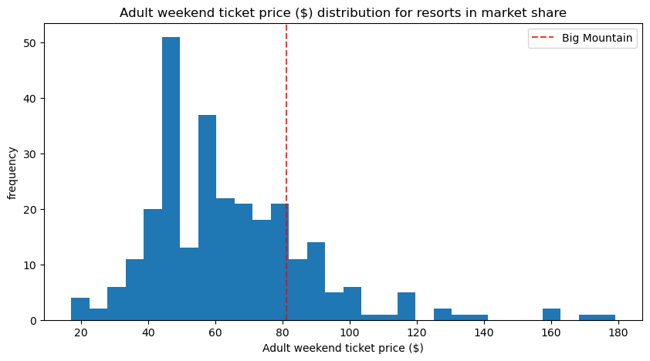
Modeling
Big Mountain Resort’s modeled price was $95.87, much higher than its actual price of $81
It is already on the higher end of ticket prices, and its modeled price would push it even higher

Slide 7
Modeling
Histograms of vertical drop, snow making area, total chairlifts, total runs, length of the longest run, and skiable terrain area
Big Mountain falls on the higher end of all these plots, justifying an increase in ticket price

Slide 8
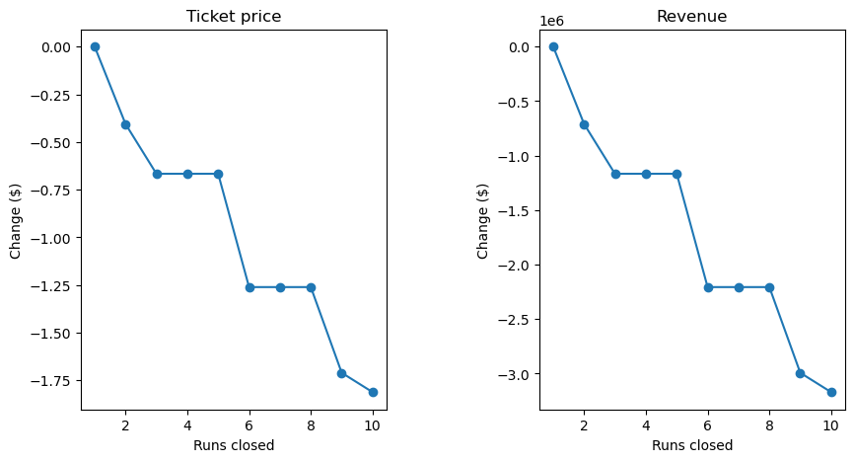
Suggestions
Based on its facilities, Big Mountain should increase ticket price by $15
The installation of an additional run 150 feet lower down supports increased ticket price by $1.99
Closing several runs would allow for lower ticket price and decreased expenditure

Slide 9
Conclusion
Big Mountain Resort’s ticket price is higher than average, but based on its facilities, it can further increase its ticket price
Revenue can be further increased by the installation of an additional run, or closing several runs
These changes will support the increased operating costs of the new chairlift

